Slide 1
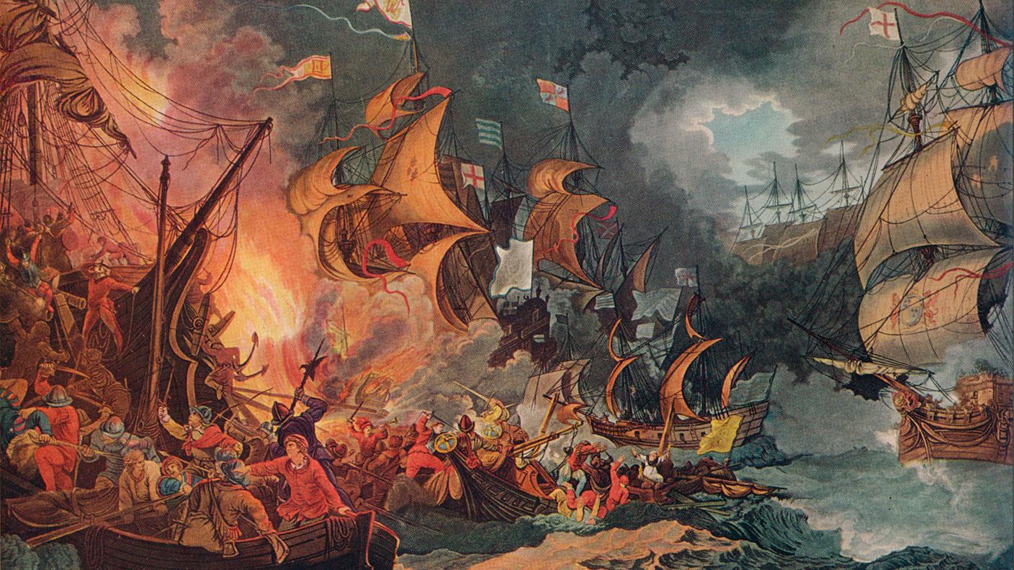
The Spanish Armada

Slide 2
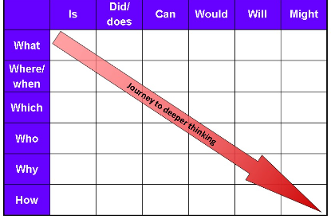

Slide 3
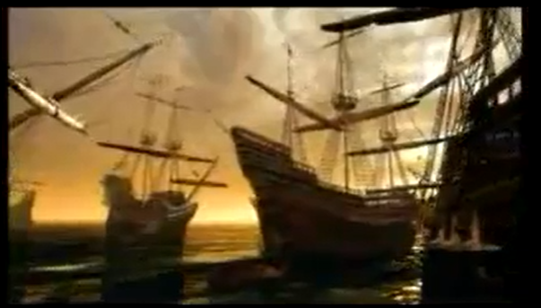
https://www.schooltube.com/media/The+Spanish+Armada/1_8zpn65rw

Slide 4
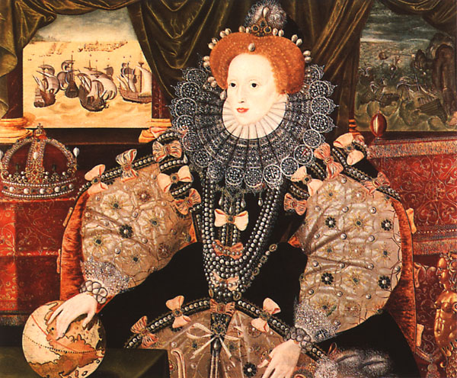
How did England defeat the Spanish?

Slide 5
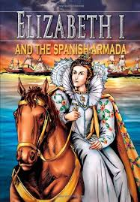
What role did Queen Elizabeth I play?

Slide 6
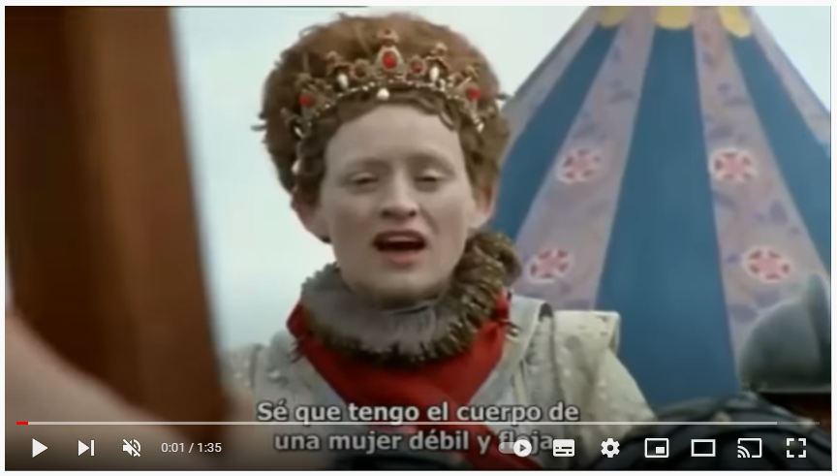
https://www.youtube.com/watch?v=OavL-FrNdlA&t=1s

Slide 7
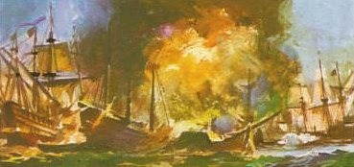
What role did the fire boats I play?

Slide 8
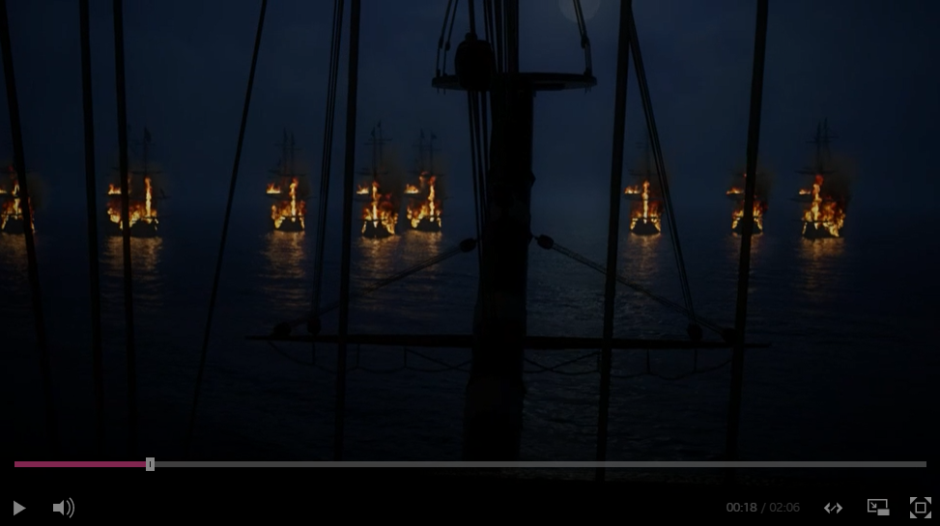
https://www.bbc.co.uk/programmes/p02stmpn

Slide 9
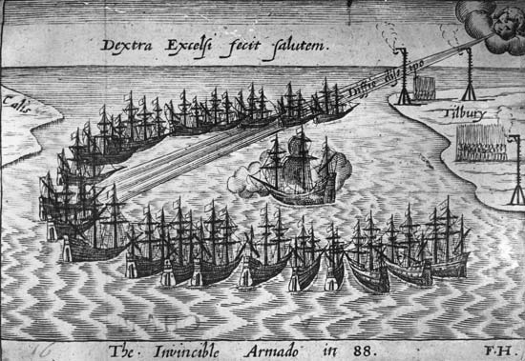
What role did the wind play?

Slide 10
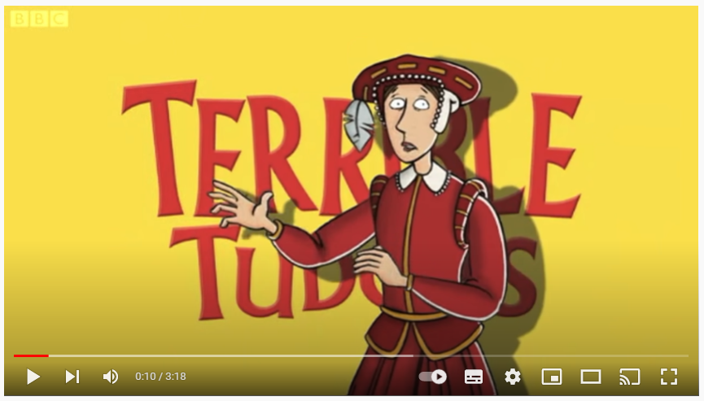
https://www.youtube.com/watch?v=SXtbrRyN9cI

Slide 11
Did the English defeat the Spanish?

